Slide 1
Service Mesh
Kubernetes on AWS
version 0.8.3

Slide 2
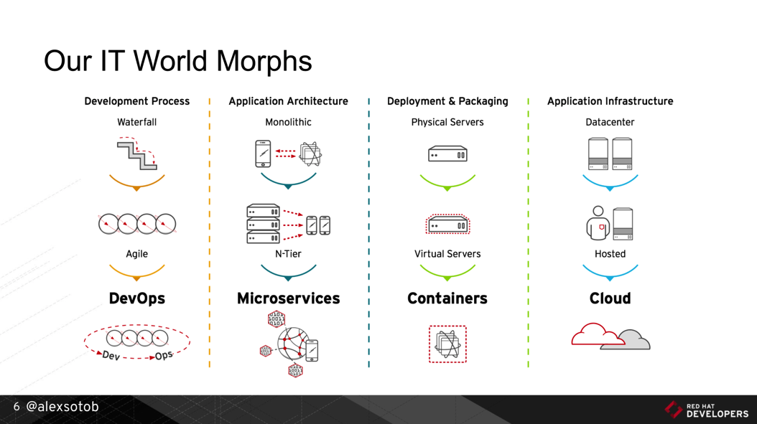
1. Digital Transformation: IT World is changing
https://www.slideshare.net/asotobu/sail-in-the-cloud

Slide 3
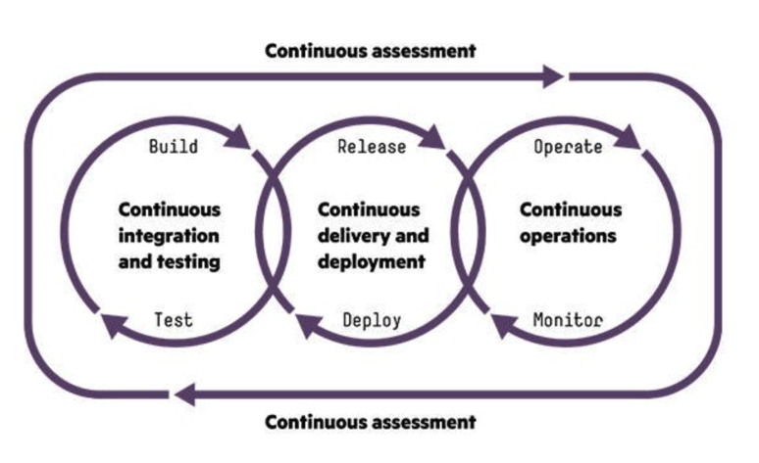
1. Digital Transformation: CI/CD, DevOps, Jenkins,..
https://www.slideshare.net/asotobu/sail-in-the-cloud

Slide 4
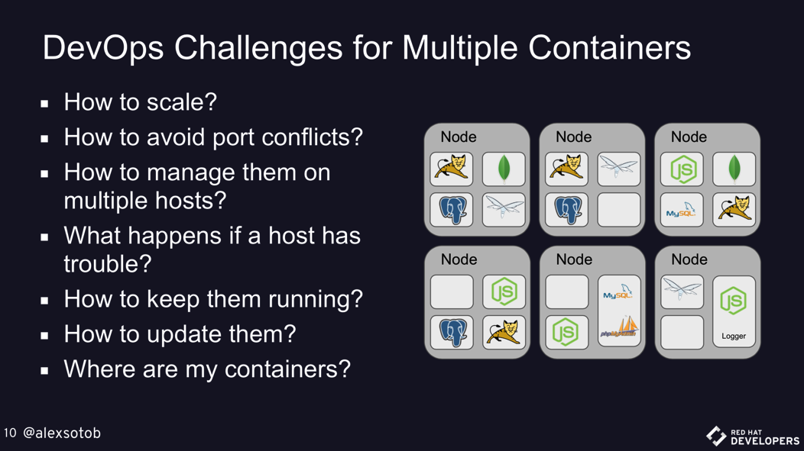
1. Digital Transformation: New challenges
https://www.slideshare.net/asotobu/sail-in-the-cloud

Slide 5
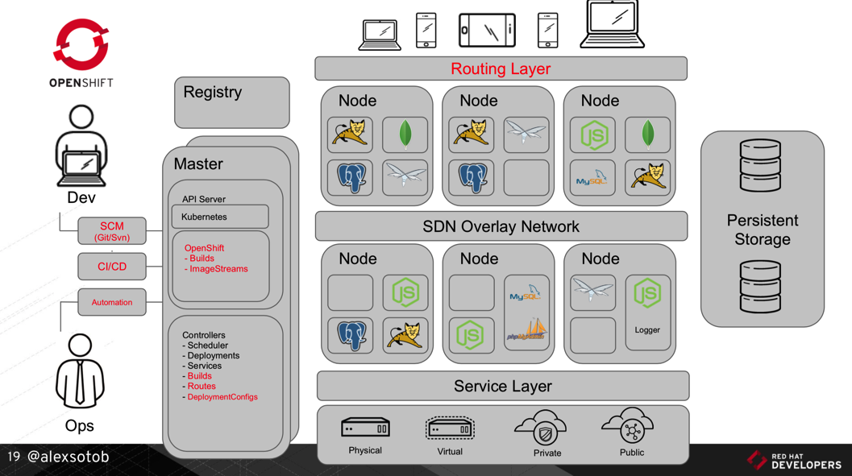
1. Digital Transformation: A new Platform
https://www.slideshare.net/asotobu/sail-in-the-cloud

Slide 6
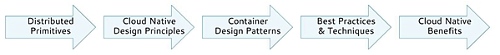
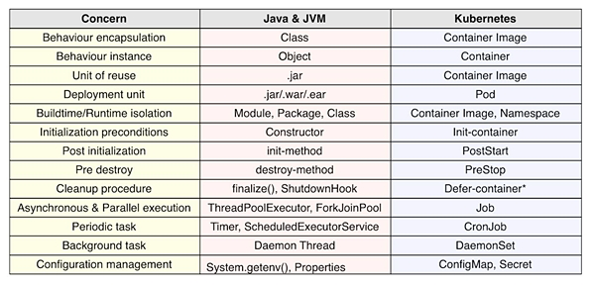
2. Kubernetes effect on the SDLC: Primitives (1/2)
1
https://www.infoq.com/articles/kubernetes-effect

Slide 7
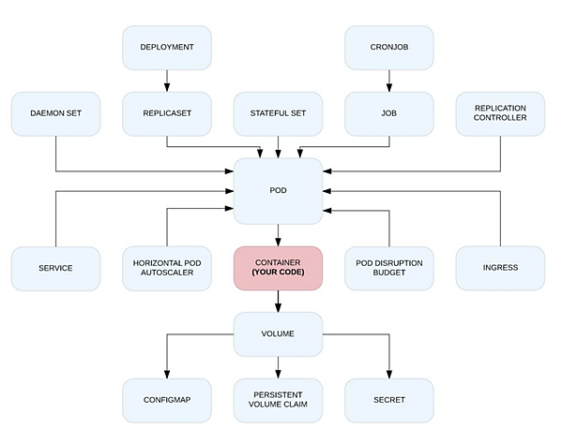
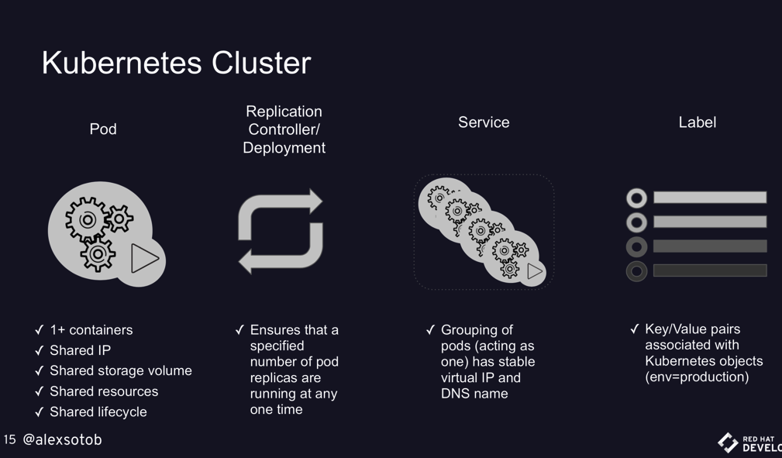
2. Kubernetes effect on the SDLC: Primitives (2/2)
1
https://www.infoq.com/articles/kubernetes-effect
https://www.slideshare.net/asotobu/sail-in-the-cloud

Slide 8
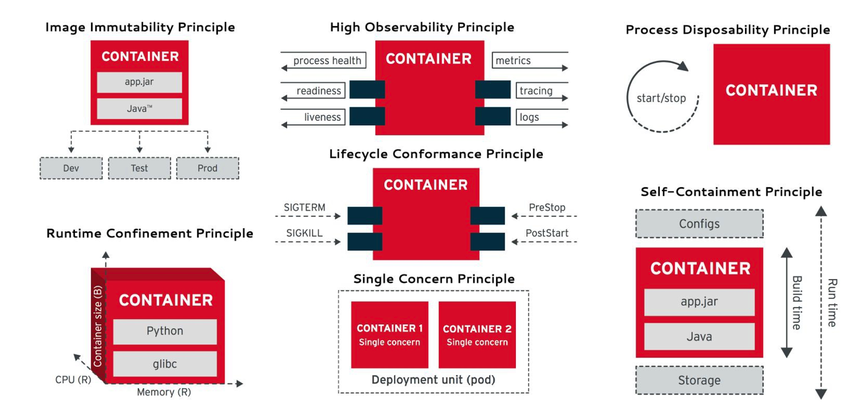
2. Kubernetes effect on the SDLC: Principles
2
https://www.infoq.com/articles/kubernetes-effect

Slide 9
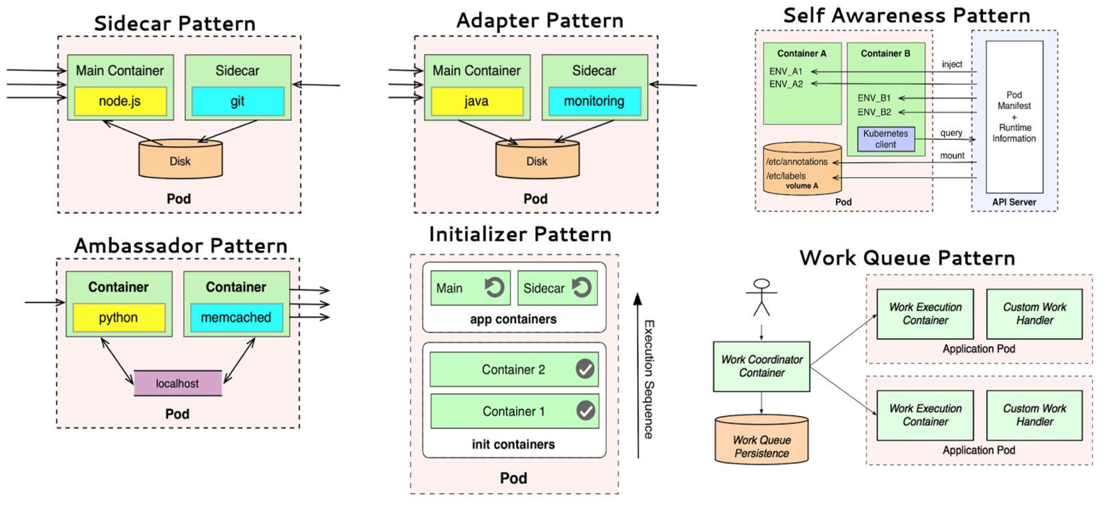
2. Kubernetes effect on the SDLC: Patterns
3
https://www.infoq.com/articles/kubernetes-effect

Slide 10
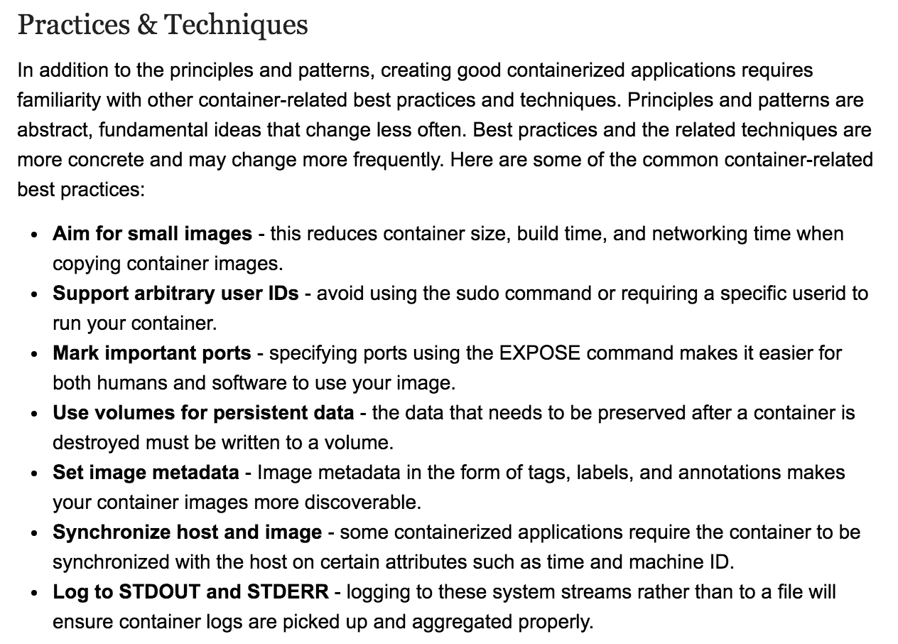
2. Kubernetes effect on the SDLC: Best Practices
4
https://www.infoq.com/articles/kubernetes-effect

Slide 11
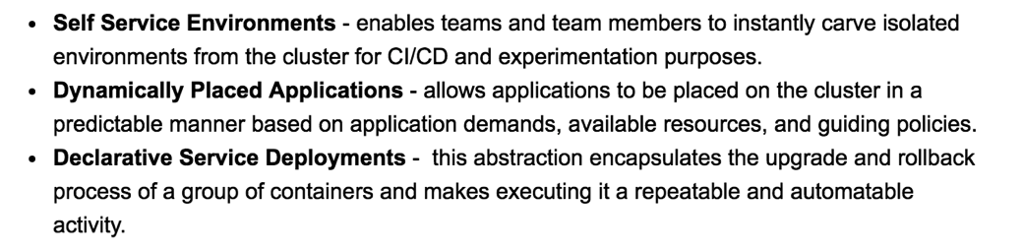
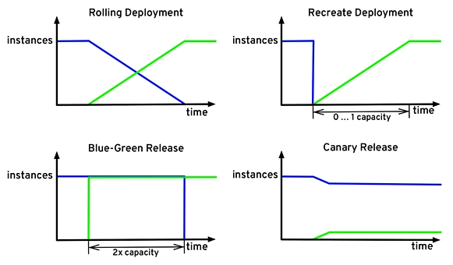
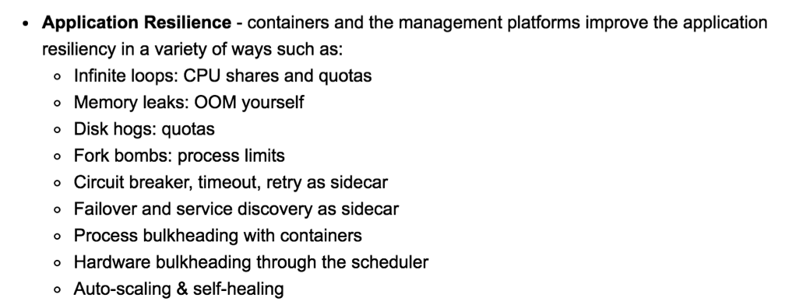
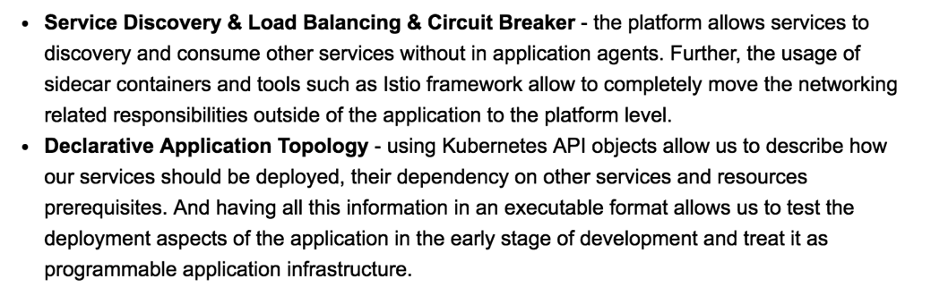
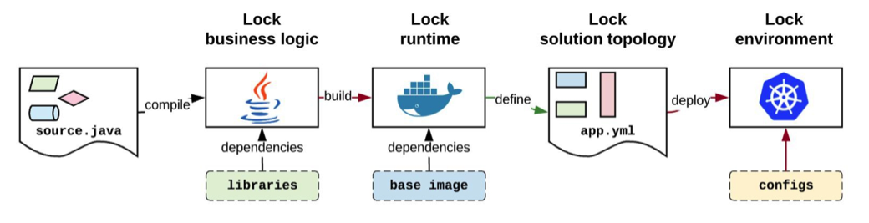
2. Kubernetes effect on the SDLC: Benefits
5
https://www.infoq.com/articles/kubernetes-effect

Slide 12

3. Lab 00: Building K8s - choose yours (1/2)
Vanilla
Kubernetes Clients
Kubernetes flavours
Self Managed
Full Managed Cloud
kubectl
(kubernetes)
Kubernetes Cluster
On-premise
Google Kubernetes Engine
KVM
VMWare
oc (openshift)
RedHat OpenShift v3
Azure Container Service (AKS)
Amazon EC2
az
(azure)
RedHat OpenShift Container Platform
Minimalist
Minikube
OpenShift
Minishift
Amazon Fargate
Amazon EKS
Amazon ECS
Managed

Slide 13
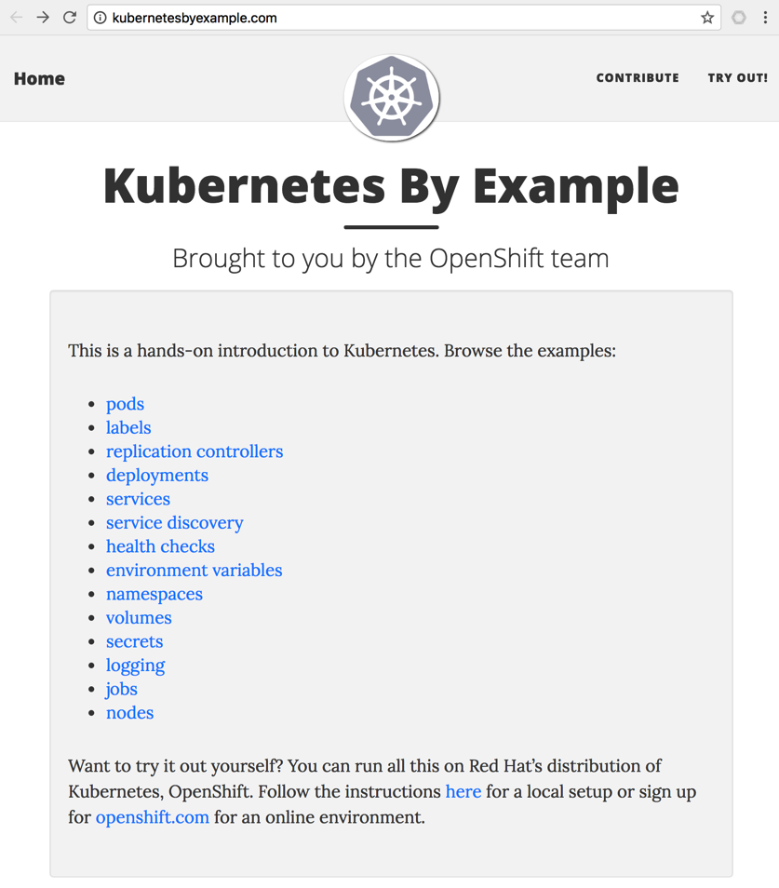
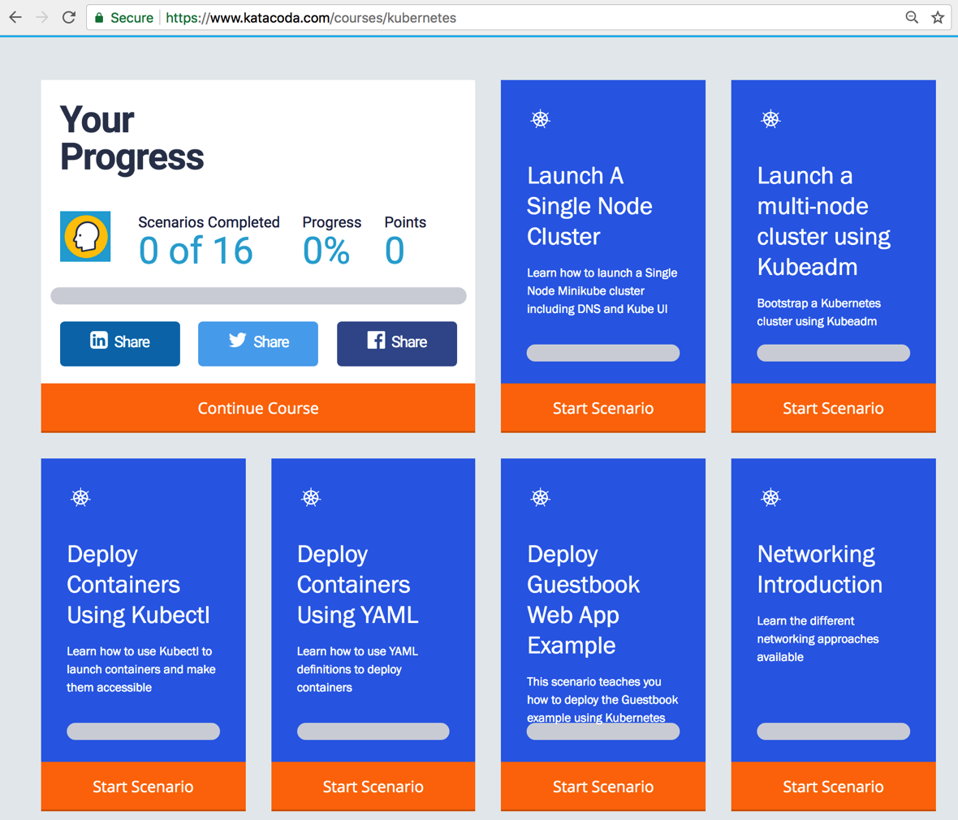
3. Lab 00: Building K8s - acquire practice (2/2)
1
http://kubernetesbyexample.com
https://www.katacoda.com/courses/kubernetes

Slide 14

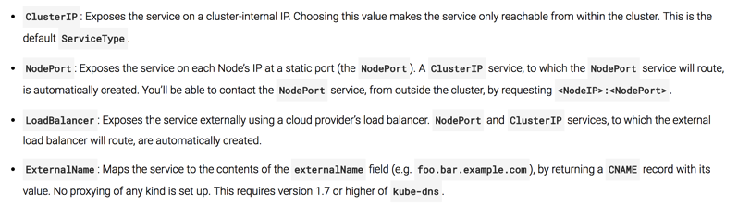
3. Lab 01: Delivering Apps (Pods & Services) 1/2
Hosting (Amazon EC2, Google Kubernetes, Minikube, etc.)
Kubernetes / Node₁
Edge Proxy
(Load Balancer)
Too difficult to add more routes.
Namespace_{A}
Port₁
LoadBalancer
Namespace_{A}
Namespace_{B}
nodePort₁
(hello-svc-lb)
Pod₁
http://<PublicIP>:<PublicPort>/hello
Pod₃
Docker₁
Docker Registry
DNS
Port₂
NodePort
nodePort₂
(hello-svc-np)
5000
(hello-v1)
Port₃
ClusterIP
Pod₂
Node₂
(hello-svc-cip)
Namespace_{C}
Docker₂
Pod₄
Any container can hit to other container running in different namespaces.
Too difficult to add security (MTLS, ACL, ..)
2
5000
(hello-v2)
1
http://<clusterIP>:<nodePort>/hello
Docker₄
Services
Deployment
http://<NodeIP>:<nodePort>/hello
http://<ServiceName>.<NameSpace>.svc.cluster.local:<port>/hello
External Network
spec.loadBalancerIp:spec.pops[*].port
Internal Network (Backend)
<NodeIP>:spec.ports[*].nodePort
spec.clusterIp:spec.ports[*].port

Slide 15
3. Lab 01: Delivering Apps (Pods & Services) 2/2
Hosting (Amazon EC2, Google Kubernetes, Minikube, etc.)
Kubernetes / Node₁
Edge Proxy
(Load Balancer)
Too difficult to add more routes.
Namespace_{A}
Port₁
LoadBalancer
Namespace_{A}
Namespace_{B}
nodePort₁
(hello-svc-lb)
Pod₁
http://<PublicIP>:<PublicPort>/hello
Pod₃
Docker₁
Docker Registry
DNS
Port₂
NodePort
nodePort₂
(hello-svc-np)
5000
(hello-v1)
Port₃
ClusterIP
Pod₂
Node₂
(hello-svc-cip)
Namespace_{C}
Docker₂
Pod₄
Any container can hit to other container running in different namespaces.
Too difficult to add security (MTLS, ACL, ..)
2
5000
(hello-v2)
1
http://<clusterIP>:<nodePort>/hello
Docker₄
Services
Deployment
http://<NodeIP>:<nodePort>/hello
http://<ServiceName>.<NameSpace>.svc.cluster.local:<port>/hello
## creating the namespace and service account
$ kubectl apply –f hello-ns-sa.yaml
## scheduling the pods to host the application
$ kubectl apply –f hello-deployment.yaml
## exposing the application as k8s services
$ kubectl apply –f hello-services.yaml
## scheduling all together
$ kubectl apply –f hello-app.yaml
## introducing a ‘malicious’ container
$ kubectl run malicious-curl --image=radial/busyboxplus:curl -it -n malicious --replicas=1
[ root@malicious-curl-6b6f76f5f9-bsl9x:/ ]$ nmap xyz
## gathering information about the services living in kubernetes
[ root@malic...:/ ]$ nslookup hello-svc-np.hello.svc.cluster.local
## calling an API from other namespace
[ root@malic...:/ ]$ curl -sv hello-svc-np.hello.svc.cluster.local:5030/hello
## DoS
[ root@malic...:/ ]$ export HELLO_URL=hello-svc-np.hello.svc.cluster.local:5030
[ root@malic...:/ ]$ while true; do curl -s -o /dev/null http://$HELLO_URL/hello; done
## getting all system environment variables available in a POD
$ kubectl exec hello-v1-69c9685b5-97vqs -n hello -- printenv

Slide 16
3. Lab 02: Exposing Services – Ingress
Hosting (Amazon EC2, Google Kubernetes, Minikube, etc.)
Kubernetes
Node₁
Ingress Controller
Namespace_{A}
Edge Proxy
(Load Balancer)
Ingress Resource₁
Namespace_{A}
LoadBalancer
....
Port₁
LoadBalancer
Namespace_{A}
Ingress Resource_{n}
nodePort₁
(hello-svc-lb)
Pod₁
http://<PublicIP>:<PublicPort>/hello
Docker₁
Docker Registry
.......
Port₂
NodePort
1
nodePort₂
(hello-svc-np)
5000
(hello-v1)
Deployment
2
3
Port₃
ClusterIP
Pod₂
Service
Ingress
(hello-svc-cip)
Docker₂
Call NodePort or ClusterIP to Pods
5000
(hello-v2)

Slide 17
3. Lab 03: Weaving Service Mesh – Ref. Arch.

Slide 18
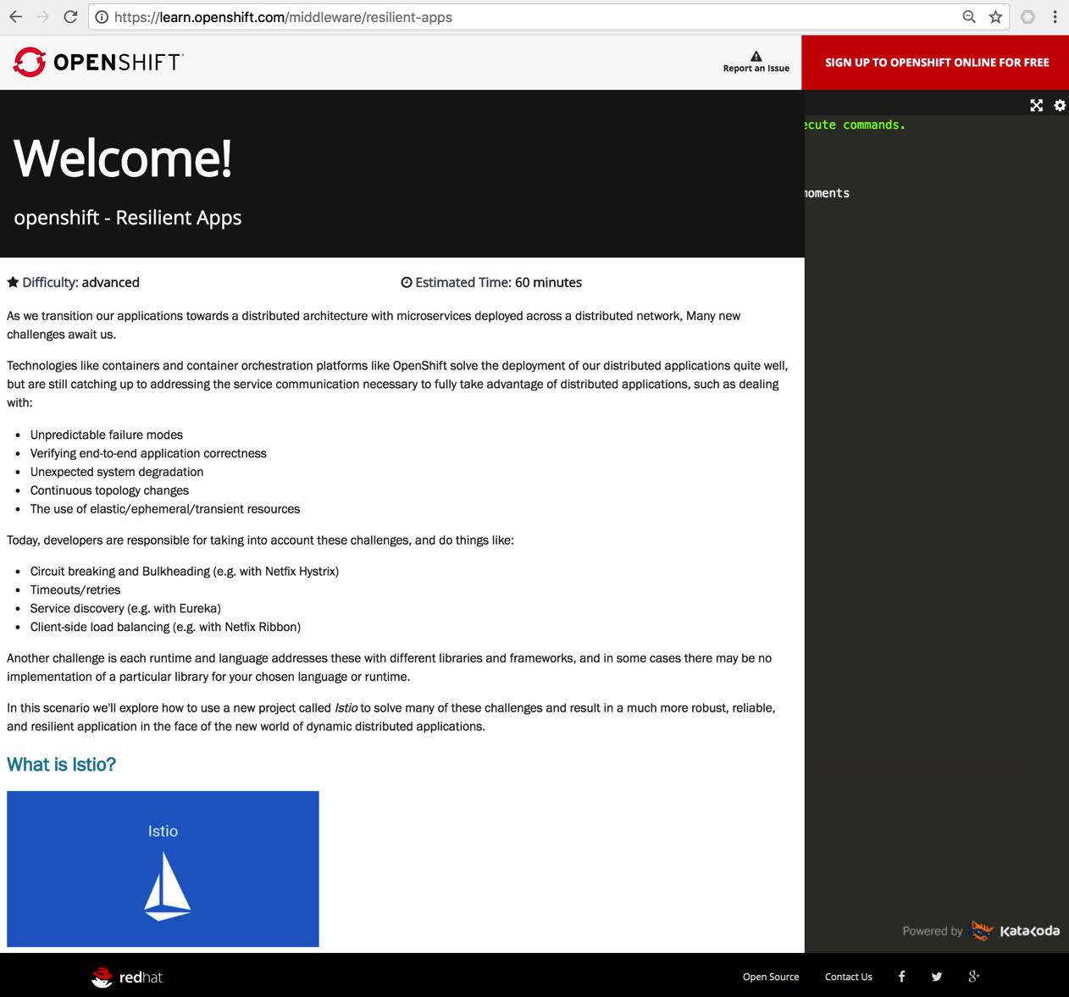
3. Lab 03: Weaving Service Mesh - Istio
https://learn.openshift.com/middleware/resilient-apps

Slide 19


3. Lab 04: Deploying on Service Mesh
Hosting
Edge Proxy
(Load Balancer)
Kubernetes
Node₁
Services
ClusterIP₁
Pod₁
Service Mesh Control Plane
Istio Ingress
Docker₁
ClusterIP₂
Sidecar₁
Istio CA
ClusterIP₃
Istio Pilot
Istio Mixer
Kubernetes
Node₂
Istio Auth
Pod₂
Docker₂

Slide 20
3. Lab 05: Chaining APIs (PoC)
Hosting
Edge Proxy
(Load Balancer)
Kubernetes
Node₁
Service Mesh Control Plane
Services
Pod₁
Pod₂
Docker₁
5
Docker₂
Istio Ingress
ClusterIP₂
(5001)
(5050)
(test1-svc)
(80)
4
(gis-test-sidecar)
(gis-test-api)
Istio CA
1
ClusterIP₁
(6000)
Istio Pilot
2
(test1-ambassador- svc)
3
Pod₃
Istio Mixer
Docker₃
Istio Auth
(gis-validator)

